Slide 1
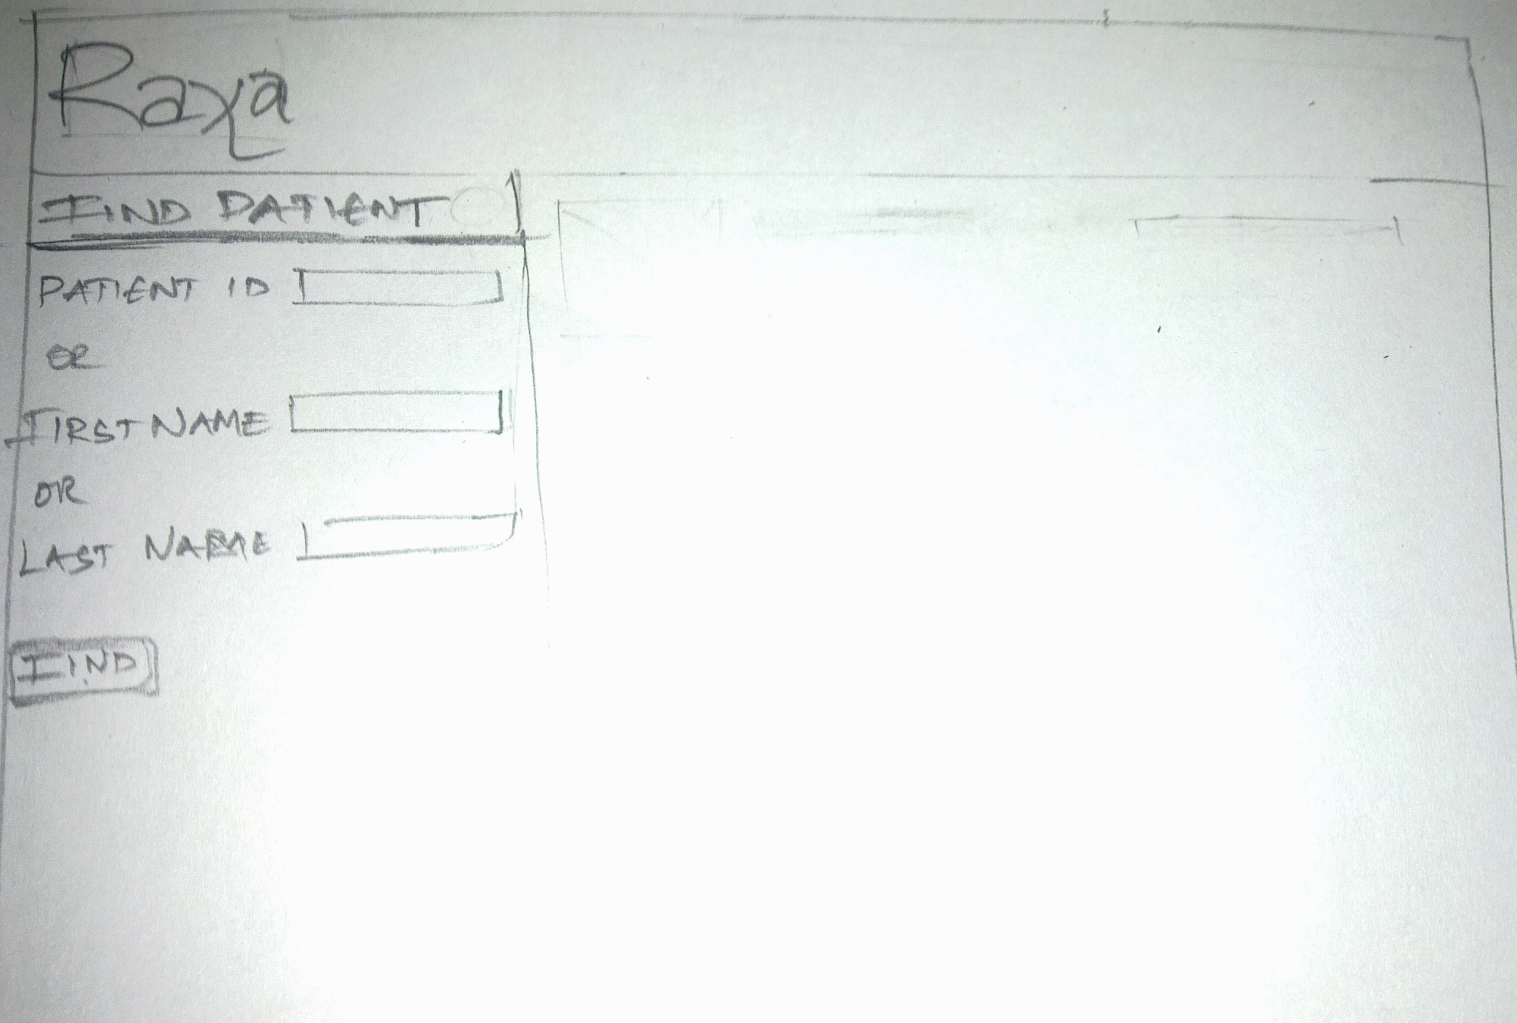
^{Ram}

Slide 2
^{Ram}

Slide 3
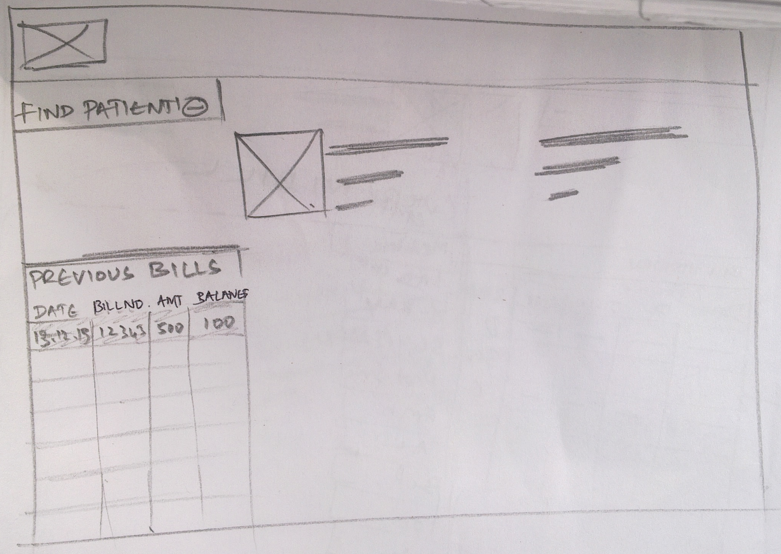
Red indicates that some bills haven’t been paid fully
13.12.1990 56745 600 0
13.12.1985 34312 600 540

Slide 4
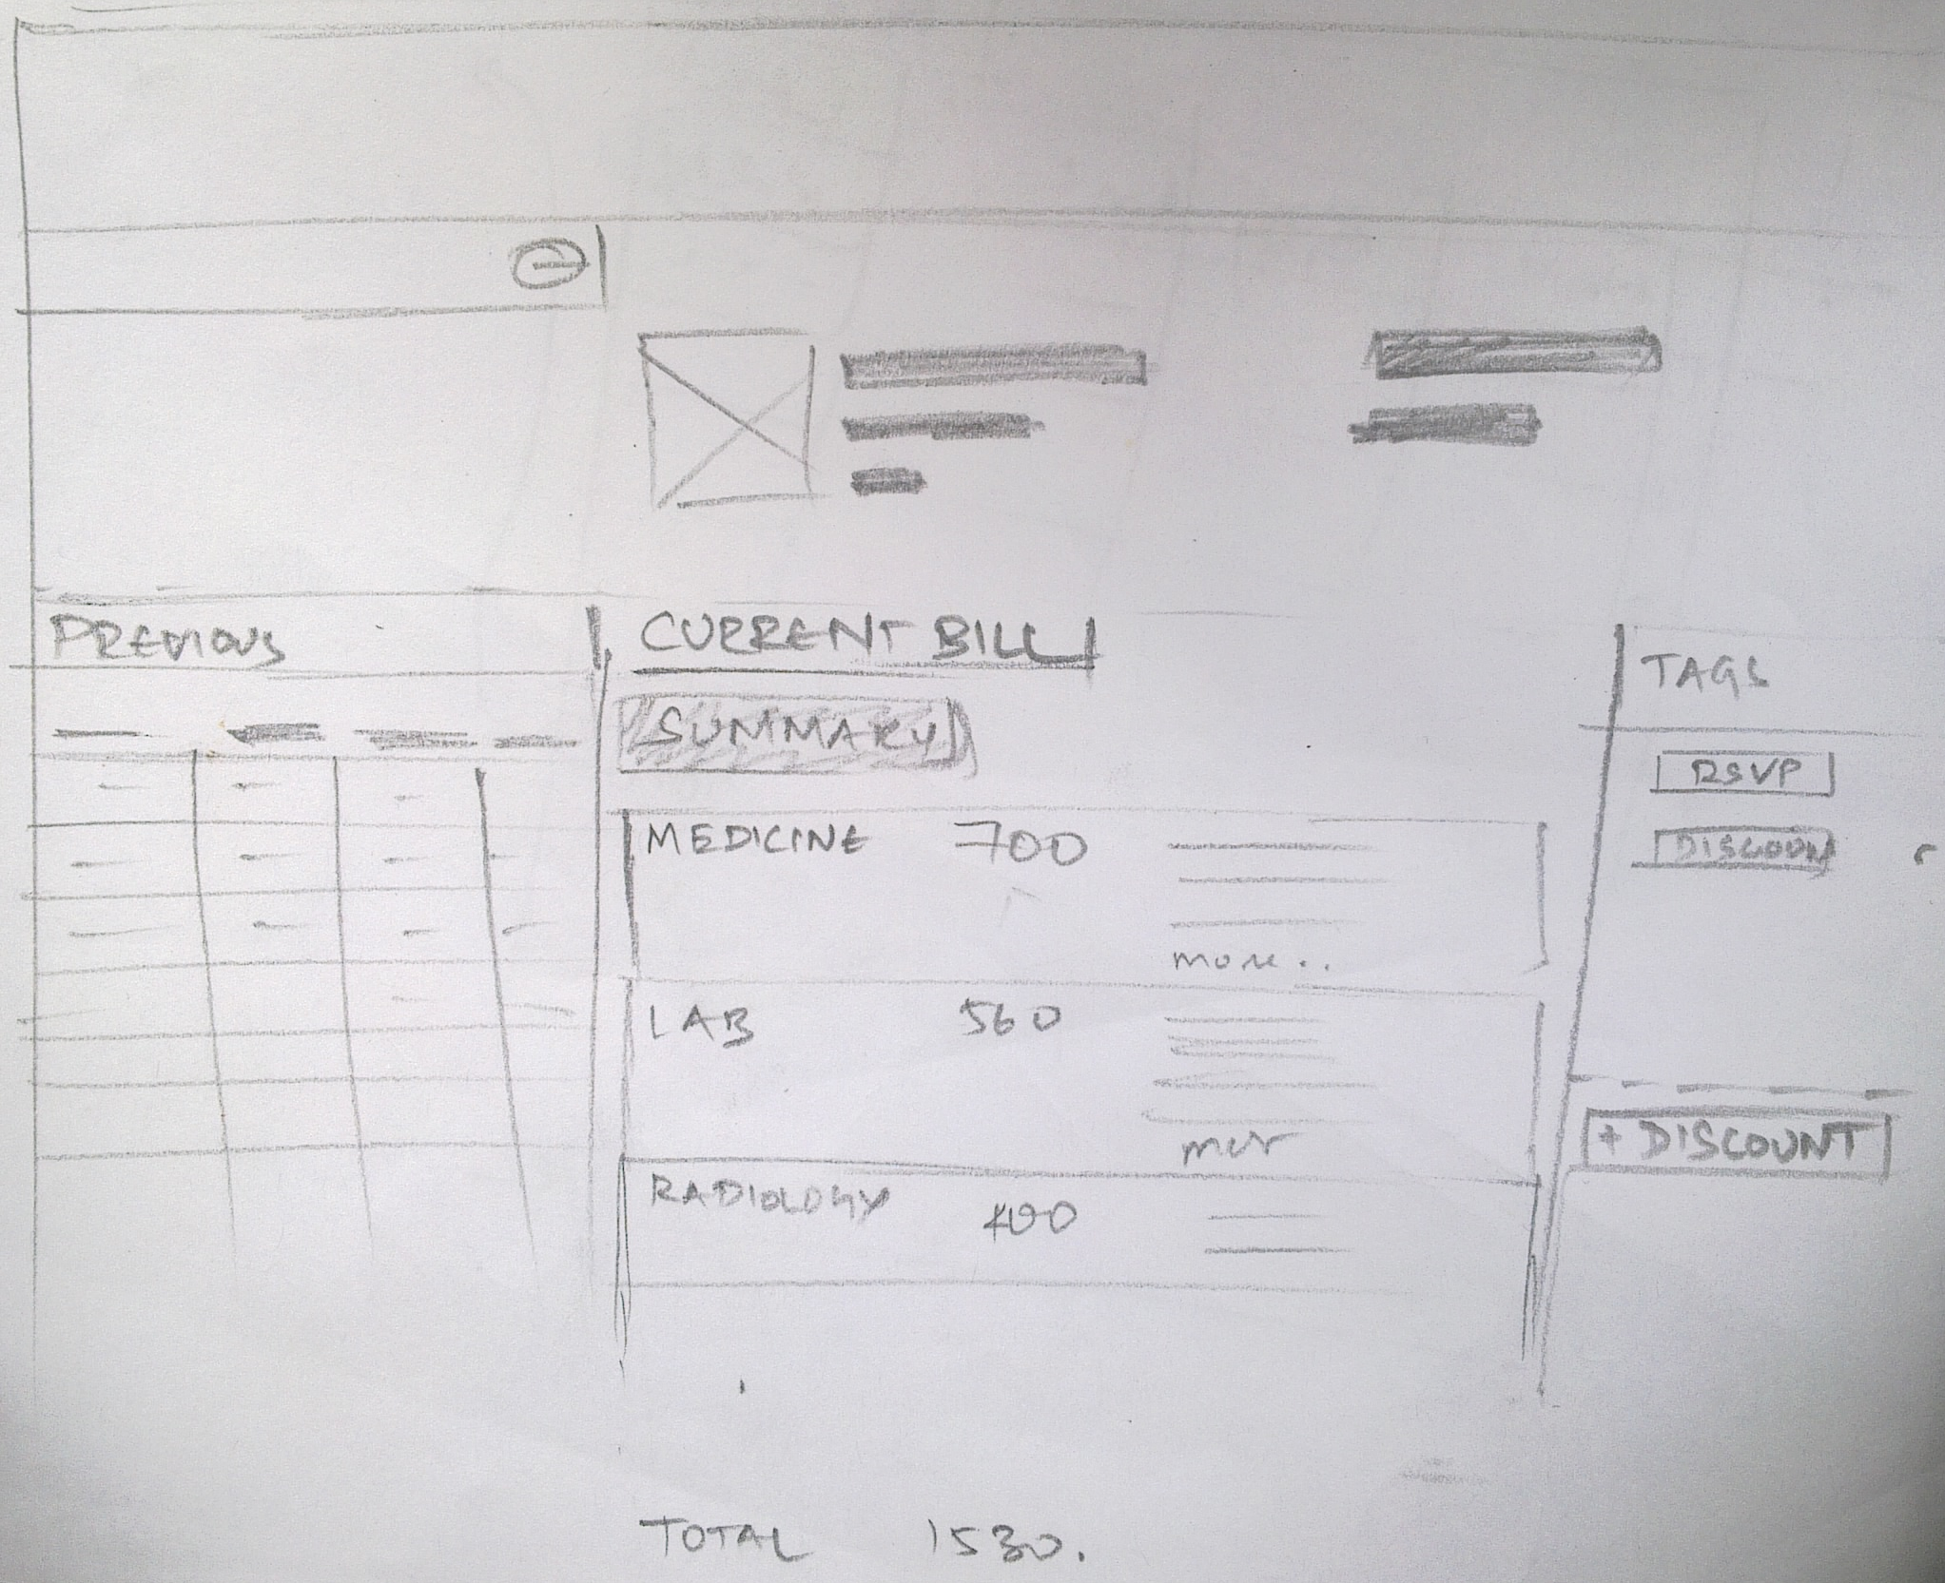
The TAGS are used to for specific schemes

Slide 5
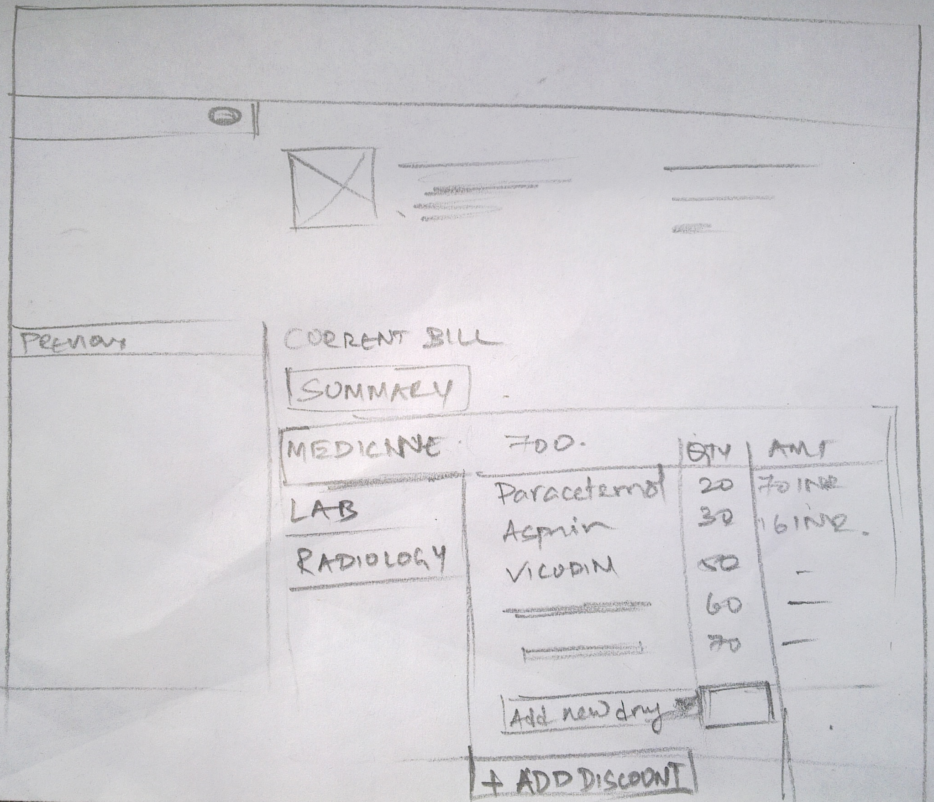
Tabbed interface to make changes to the bill

Slide 6
Add Discount
Reason
OPD Doctor
Other Reason
Notes
Add
Add Another

Slide 7
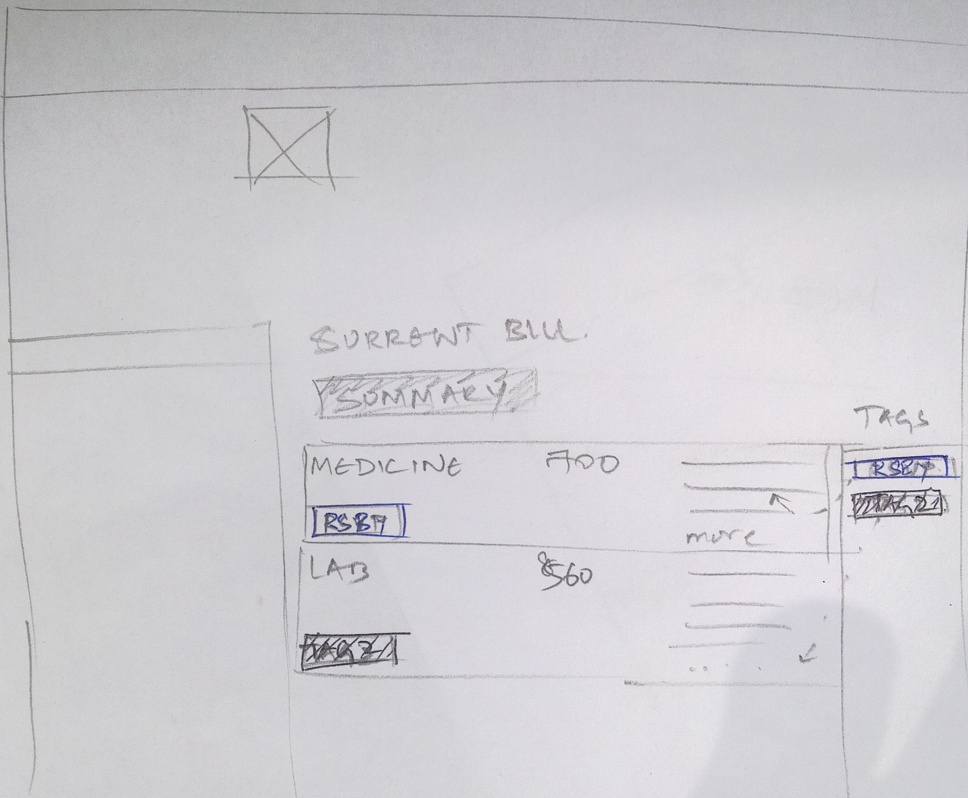
RSBY tag dragged and dropped under MEDICINE
COLLECT MONEY

Slide 8
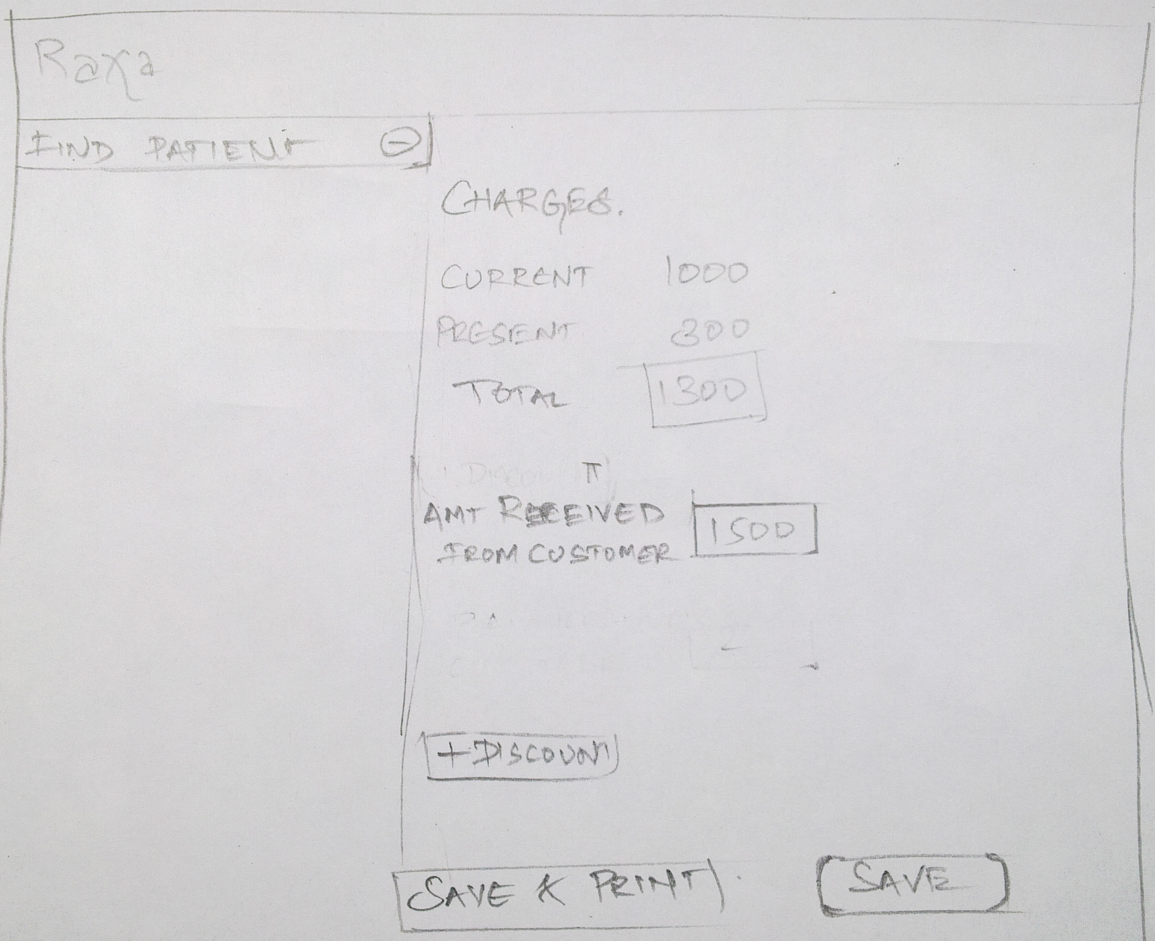
Notes:
Put POPUP, of what happens from Drag and Drop – Tags
RSBY is a INSURANCE SCHEME

